Slide 1
Home Page Redesign Usability Test ROUND 2 pictures for research report
Nov 15, 2022
Cindy Merrill

Slide 2
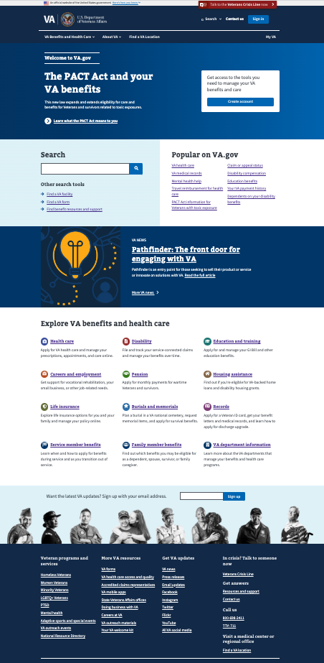
% of 11 research participants who clicked in each area
64%
27%
0%*
Where people clicked:
Popular (73% = 8/11 participants)
Header (64% = 7/11)
Benefit hubs (55% = 6/11)
Footer (55% = 6/11)
Other search tools (45% = 5/11)
VA News promo (36% = 4/11)
Benefit promo–top of pg (27% = 3/11)
New search box (27% = 3/11)
Create account button (0%)
*0% is OK because all participants already had accounts to sign into VA.gov, and there weren’t any tasks related to this
27%
73%
45%
Key:
70-100%
50-69%
30-49%
10-29%
0-9%
36%
55%
55%
11 participants = 8 mobile + 3 desktop (screenshot shows desktop version but includes both mobile & desktop click data)

Slide 3
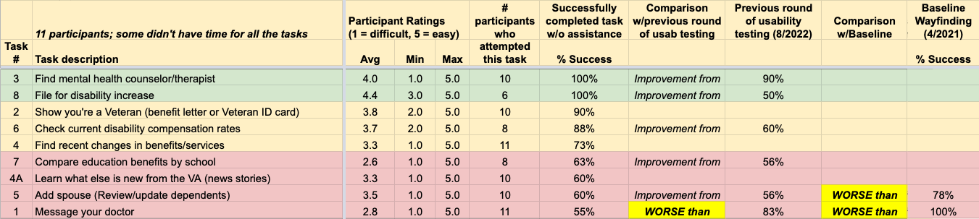
Task success rates and ratings

Slide 4
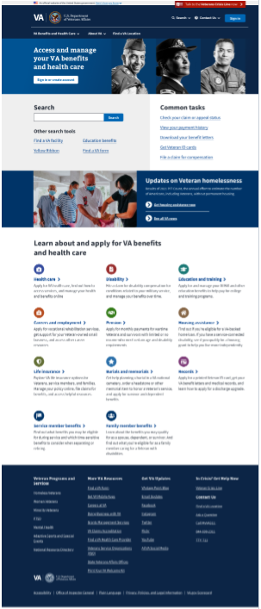
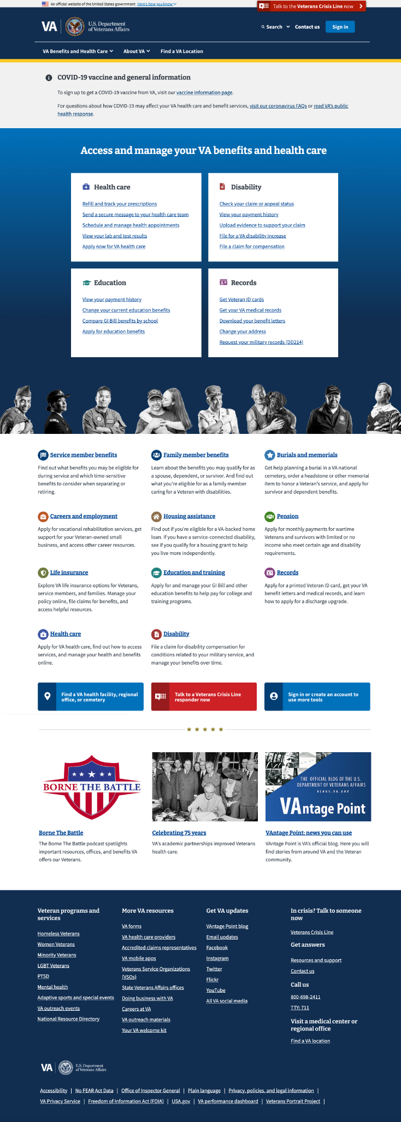
Compare home page usage across research studies
Key:
70-100%
50-69%
30-49%
10-29%
0-9%
(screenshots show desktop version but include desktop & mobile participants together)
Home page usability round 2 (10/2022 with 11 participants)
Home page usability round 1 (8/2022 w/19 participants)
Baseline Wayfinding (5/2021 w/13 participants)

Slide 5
Areas of the redesigned VA.gov
home page tested
Header
Benefit promo
Create account
New search box
Popular on VA.gov
Other search tools
VA News promo
Benefit hubs
Footer

Slide 7
Scratch

Slide 8
Home Page Redesign Research round #1
% of 19 research participants who clicked in each area
74%
16%
47%
Where people clicked:
Header (74% = 14/19 participants)
Common tasks (68% = 13/19)
Benefit hubs (68% = 13/19)
Other search tools (63% = 12/19)
New search box (47% = 9/19)
Footer (21% = 4/19)
Sign in or create account button (16% = 3/19)
*0% is OK because we didn’t have any tasks that related to the Vantage part of the page
68%
63%
0%*
Key:
70-100%
50-69%
25-49%
10-24%
0-9%
68%
21%

Slide 9
% of 13 research participants who clicked in each area (Desktop + Mobile)
Baseline Wayfinding
Key:
70-100%
50-69%
30-49%
10-29%
0-9%

